Slide 1

Fast R-CNN (Region-based Convolutional Network)
Written by Ross Girshick
Presented by Minsung Cho

Slide 2
Table of Contents
Short Summary
Assessment of Strengths
Assessment of Weaknesses
Questions Regarding the Work

Slide 3
Short Summary
The problem that is being addressed:
Training is a multi-stage pipeline
Training is expensive in space and time
Object detection is slow.
Its significance:
9x faster than R-CNN (0.3s to process images at runtime)
Higher mAP of 66% (vs. 62% for R-CNN)
Approach used to solve the problems:
The RoI pooling layer
Initializing from pre-trained networks
Fine-tuning
Setup:
CaffeNet with Python and C++
VOC07, 2010, and 2012 vs SPPNet, R-CNN, SegDeepM, and BabyLearning

Slide 4
What is CNN?
Convolutional Neural Network
Input -> Convolutional layer (transformed) -> output
Features
Objects, textures, edges, shapes, etc.
Layers = Filters
Simple layers(edge 3x3) -> intermediate layers(corners, shapes) -> complicated layers(dog, cat)

Slide 5
What is relu(Rectified Linear Unit) Activation function and backpropagation?
First, neural network consists of nodes and connections between the nodes that provides the weights and biases.
Back propagation fills the empty parameters -> slope and intercept
Bent activation node, zero until a point, rest is linear.
Chain rule and gradient descent to provide the weights and biases for backpropagation.
First determine the last parameter bias by gradient descent and with optimal past parameters.
Then use derivative of SSR over the last parameter bias.

Slide 6
What is max pooling & Softmax
Follows the convolutional layer output.
Decreases the image pixel width and height.
Defined by filter size (like 2x2) and stride(how many pixel to slide).
SoftMax = higher dimension sigmoid.
Goal is to transform the unbounded probability into a probability vector.
It uses euler’s exponent.

Slide 7
What is R-CNN?
Input image -> selective search -> initial segmentation -> after many iteration -> bounding box -> into the CNN
Extract region proposal from bounding box -> crop -> CNN -> classification
Problem addressed:
Region loses detail when cropped to fit into the fixed-sized CNN.
There could be too much bounding box to pass to the CNN and they have to pass one by one
Significance of the problems:
Computationally expensive.

Slide 8
Fast R-CNN
Approach used to solve the problems:
Still does selective search region proposals.
Passes the entire image into the deep ConvNet other than each RoI -> the bounding box is projected onto the RoI feature map -> RoI pooling layer makes the projection into a fixed size -> Fully connected network classification CNN
Because CNN is just layers of filters and max pooling, it can estimate at the end of the image output.
There may exist yet undiscovered techniques that allow dense boxes to perform as well as sparse proposals (wink wink)

Slide 9
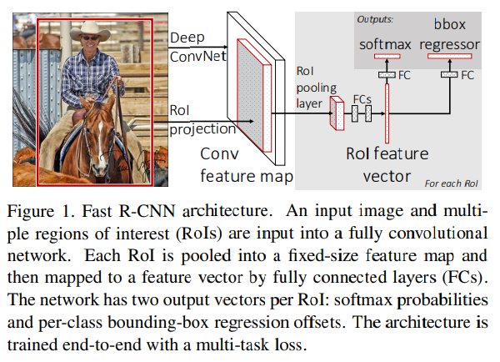
Fast R-CNN

Slide 10
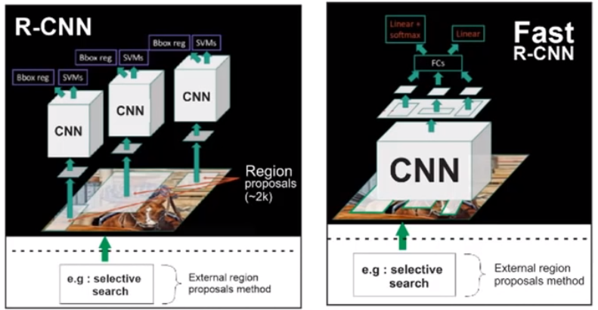
R-CNN vs Fast r-cnn

Slide 11
Fine tuning
Uses Stochastic gradient descent (just like regular gradient descent but random and better to update) for mini-batch sampling (25% of the RoIs).
2 output layers:
Discrete probability distribution per RoI over K+1 categories.
Bounding-box regression offset for each of the K object classes.
Back propagation routes derivatives through the RoI pooling layer.
SGD hyper-parameter: softmax & bounding-box initialized from zero-mean Gaussian distribution with standard deviations 0.01 and 0.001.
Using both brute force(single scale) and image pyramid for scale invariance

Slide 12
Assessment of strengths
Higher detection quality (mAP) than R-CNN, SPPNet
Training is single-stage, using a multi-task loss
Training can update all network layers
No disk storage is required for feature caching
softmax slightly outperforming SVM

Slide 13
Training and testing time
For VGG16, Fast R-CNN processes images 146× faster than R-CNN without truncated SVD and 213× faster with it.
Training time is reduced by 9×, from 84 hours to 9.5.
Compared to SPPnet, Fast RCNN trains VGG16 2.7× faster (in 9.5 vs. 25.5 hours) and tests 7× faster without truncated SVD or 10× faster with it.
Fast R-CNN also eliminates hundreds of gigabytes of disk storage, because it does not cache features.

Slide 14
Assessment of weaknesses
Assumptions that are used:
Brute force(single-scale)
Multi-task training
Training data size
When the algorithm might fail:
Scale invariance - Larger networks with a single-scale offer the best speed / accuracy tradeoff.
The multi-scale approach offers only a small increase in mAP at a large cost in compute time.
Across all three networks we observe that multi-task training improves pure classification accuracy relative to training for classification alone.
Enlarging the training set improves mAP.
+ Problems mentioned before

Slide 15
Faster R-CNN (The next gen)
The entire image is fed through the convolutional layers for feature extraction just like the Fast R-CNN.
The difference: the projection on the feature maps is not from the selective cells -> Uses RPN(Region Proposal Network) after the CNN output.
Uses anchor and its intersection of union ratio 7:3 to determine the object bounding box
No selective cells -> the feature map -> passed into the RPN CNN -> gets object classification, bounding box, and whether an object is present -> RoI pooling and classifier

Slide 16
Questions Regarding the Work
Later works that replaced Fast R-CNN:
Faster R-CNN -> Mask R-CNN Detectron(Facebook)
YOLO (You only look once)
Single Shot Detectors(SSD)

